Slide 1
Architrino Paths
and Causal Wakes

Slide 2
Architrino with Velocity v = 0
r = c_{f} t
Wake Speed c_{f} is a Primitive Constant
Absolute
Space
Causal Wake Tracers
An architrino at rest in the absolute frame emits causal wake surfaces from a common position.
Absolute Time
J Mark Morris

Slide 3
Architrino on Linear Path with Velocity v < c_{f}
r = c_{f} t
Wake Speed c_{f} is a Primitive Constant
Architrino Path
Absolute
Space
v < c_{f}
Causal Wake Tracers
Each architrino continuously emits a causal wake.
The wake is sourced by polarity and spreads over causal isochrons with 1/r^2 surface density.
When v < c_{f} the architrino does not intercept its own wake, so this is the partner-only regime.
Absolute Time
J Mark Morris

Slide 4
Causal Wake Surfaces Expand at v = c_{f}
Each Causal Isochron Expands from the Emission Point
r = c_{f} t
Wake Speed c_{f} is a Primitive Constant
Absolute
Space
Architrino Path
v < c_{f}
Causal Wake Tracers
Absolute Time
J Mark Morris

Slide 5
A Wake Hit Occurs when a Wake Intersects an Architrino
Hit = radial intersection of wake from emission point
r = c_{f} t
Absolute
Space
Architrino Path
v < c_{f}
Absolute Time
J Mark Morris

Slide 6
Architrino on Linear Path with Velocity v = c_{f}
c_{f}
v = c_{f}
Absolute
Space
Causal Wake Tracers
At v = c_{f}, an architrino is at the wake-speed threshold.
It does not yet retain a self-hit.
This threshold is the symmetry-breaking point.
It separates partner-only from self-hit-capable regimes in binary reductions.
Horizon language remains a comparison, not a closed derivation.
Absolute Time
J Mark Morris

Slide 7
Architrino on Linear Path with Velocity v > c_{f}
c_{f}
Absolute
Space
v > c_{f}
Causal Wake Tracers
Imagine an architrino with linear velocity v > c_{f}, above wake speed.
The source can outrun earlier wake surfaces.
When a same-source causal root exists, the architrino can receive self-hit feedback.
Absolute Time
J Mark Morris

Slide 8
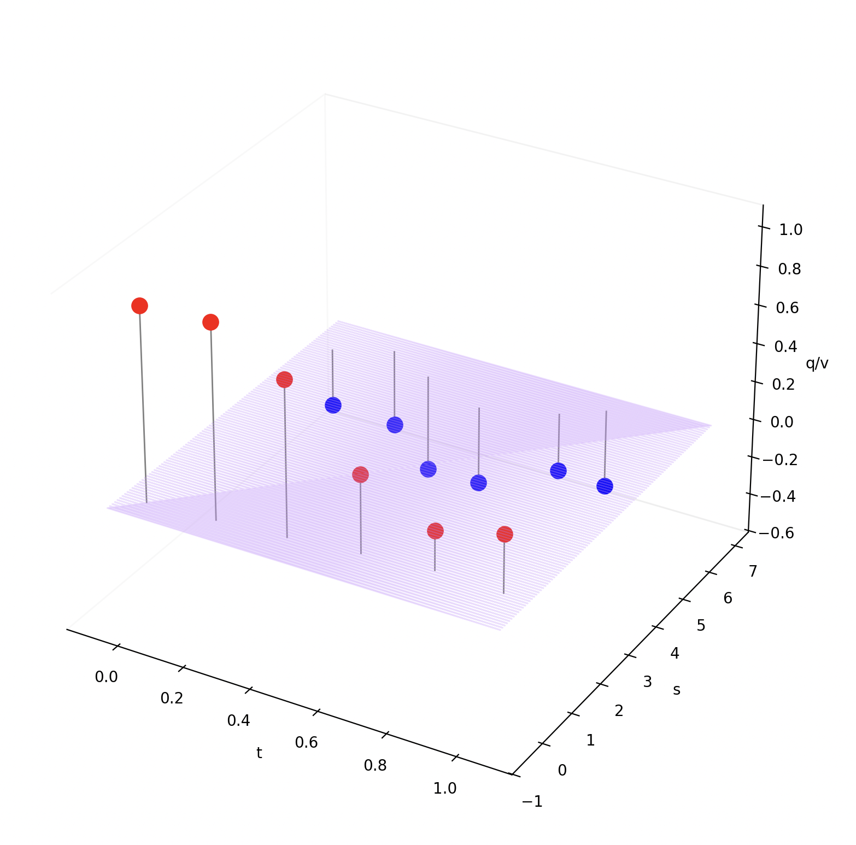
Wake Strength Depends on Path
Paths are continuous in absolute time and absolute space.
Emission rate is modeled as a constant polarity-source rate.
At v = 0, wake strength is q.
For v > 0, received strength depends on source motion and causal-root geometry.
Wake-surface density decreases as 1/r² with radius from the emission point.
J Mark Morris

Slide 9
Architrino Path History and Wake Hits
A
A(t)
Absolute
Space
A(t’)
B(t)
B
The causal wake emitted by architrino A at time t' expands at wake speed c_{f}.
A hit occurs when that wake surface intersects architrino B at time t.
Absolute Time
J Mark Morris

Slide 10
Architrino Path History and Wake Hits
Causal-delay feedback is continuous.
A hit on A changes A's path, which changes the causal wakes A emits.
After a path-dependent travel time, those wakes can hit B and change B's path.
The coupled result is path-history feedback.
A(t)
A
Absolute
Space
A(t’)
B
B(t)
Absolute Time
J Mark Morris

Slide 11
Architrino Path History and Wake Hits
A(t)
Absolute
Space
A(t’)
B(t)
The causal wake emitted by A at time t' hits B at time t.
Absolute Time
J Mark Morris

Slide 12
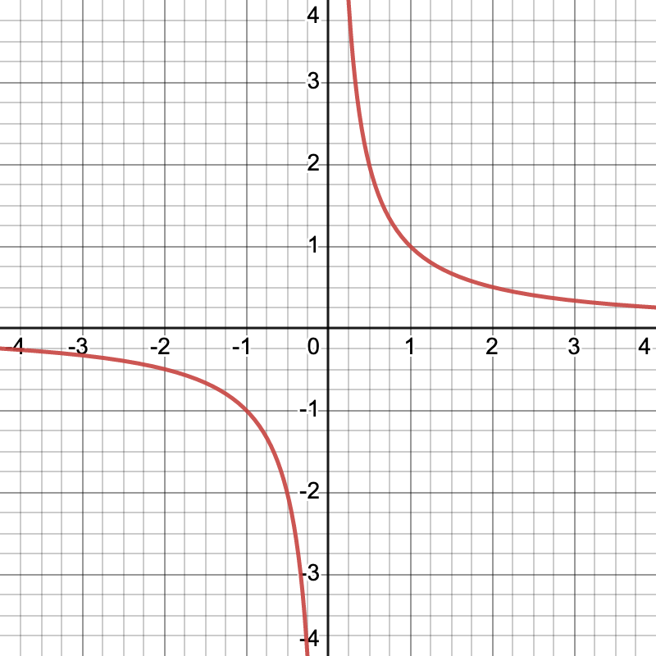
Wake Radius and Binary Symmetry
A 1D absolute space with two architrino emitters and wake speed c_{f}.
The binary symmetry point occurs when architrino speed |v| = c_{f}.
Question: does the binary symmetry point align with the reciprocal 1/r hinge at r = 1?
  One-sided integrals above and below r = 1 appear symmetric in this toy picture.
  This may explain why orbit equations scale jointly with |v| and r.
  Opposite-polarity architrinos launched from large r with small speed may approach |v| near c_{f} at r = 1.
Open calculation: determine the limiting speed after the pair passes through.
  Same-polarity architrinos launched toward each other above c_{f} may reverse or cross depending on initial offset.
  Same-polarity versus opposite-polarity motion is a real asymmetry in the primitive dynamics.
    Radius and velocity remain coupled through the causal-root ledger.

Slide 13
Architrino Assembly Architecture
Absolute
Space
Absolute Time
  linear universal parameter
  absolute space
fixed 3D container
  no preferred origin, orientation, or translation
  Architrinos
positrino/electrino polarity
  emitters and receivers
  path history in absolute timespace
  can move faster than wake speed
  Architrino Paths
  continuous history in time and space
path = all [q,t,x,y,z,x',y',z'] for all t < t_{now}
  Causal Wakes
  emitted from path history
constant polarity-source rate
  causal isochron / wake surface
  expands at wake speed c_{f}; r = c_{f} t
  Wake Hits
  received at t = t_{now}
  intersection with wake surface
superposition of received hits
  net response changes path
  Noether Sea (Large Scale)
  population per volume
  energy carried by architrino assemblies
locally neutral polarity distribution
t = t_{now}
Absolute Time
J Mark Morris

Slide 14
Zeno’s Paradox, Causal Wakes, and the 1/r Curve
Zeno’s paradox becomes a causal-root problem
Zeno’s paradox asks how motion can ever complete if every trip can be divided into endlessly smaller remaining distances.
In AAA, a similar confusion appears near a 1/r curve. If r approaches 0, the curve seems to demand an infinite response.
That static curve is not the primitive geometry.
An architrino follows a continuous path in absolute time and absolute space. Its causal wakes come from earlier path history and expand at finite wake speed c_{f}.
A received hit occurs only when a causal wake surface intersects a receiver.
So the real question near r = 0 is not what the curve does at zero. It is which causal roots exist, what hit sequence is received, and whether the feedback settles into a branch, diverges, or becomes invalid.
J Mark Morris

